Slide 1
MECHANICAL TEAM WEEK 8
CATHERINE KIPKAZI

Slide 2
TASKS COMPLETED
Motor-flywheel coupling design completion
Job card acquisition
Steering wheel effort and angle determination
Steering design completion

Slide 3
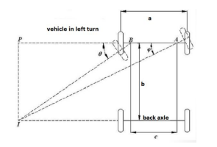
Wheelbase (b)= 1110mm
Track width (a)= 723mm
KPI to KPI distance (c)= 460mm
Steering wheel diameter=360mm
R=Outside turning radius=6000mm
Est pinion diameter= 22mm
Est lock-lock rack dist= 70mm
R

Slide 4
TRACTOR PARAMETERS
Wheelbase (b)= 1110mm
Track width (a)= 723mm
KPI to KPI distance (c)= 460mm
Steering wheel diameter=360mm
R=Outside turning radius=6000mm
Est pinion diameter= 22mm
Est lock-lock rack dist= 70mm

Slide 5
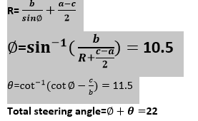
Outside steering angle=∅ =10.5
Inside steering angle=θ= 11.5

Slide 6
Total angle turned by steering wheel
= lock to lock rack dist/ (2*3.14*pinion radius)
= 1.01turns *360= 364 degrees
Steering ratio = 364/22= 16
=16:1
NOTE: initially estimated at 14:1

Slide 7

The calculations for steering wheel toque as follows,
W=Front axle weight=160kg
U=Coefficient of friction=0.7
E=kingpin offset=135mm
B=Width of tire=100mm
T= kingpin torque = 156.3 N-M

Slide 8
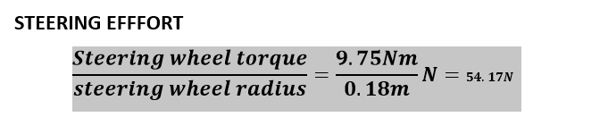

Slide 9
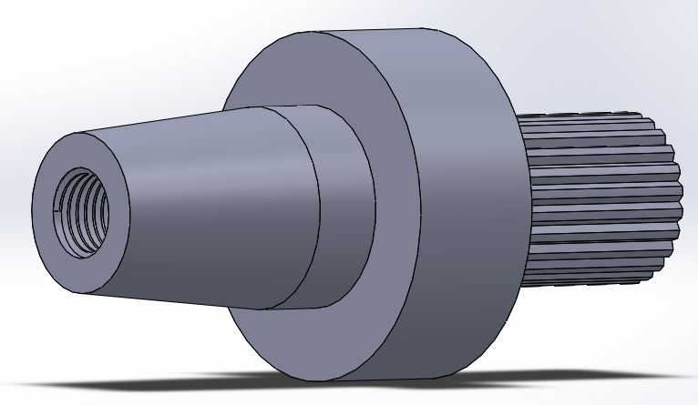
MOTOR COUPLING

Slide 10
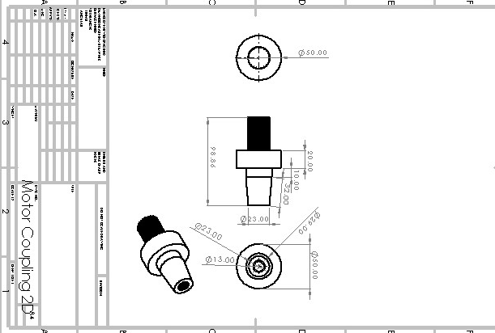
MOTOR COUPLING MECHANICAL DRAWING

Slide 11
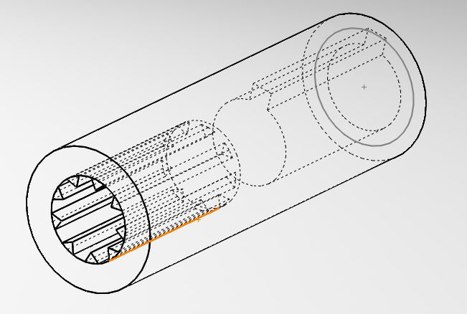
PUMP COUPLING

Slide 12
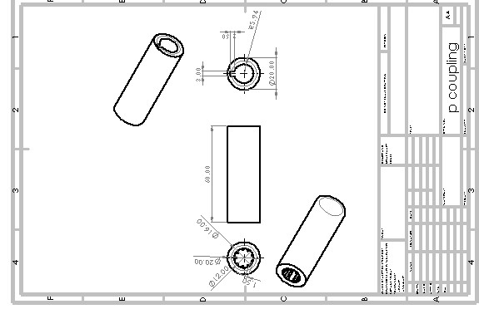
PRESENTATION

Slide 13
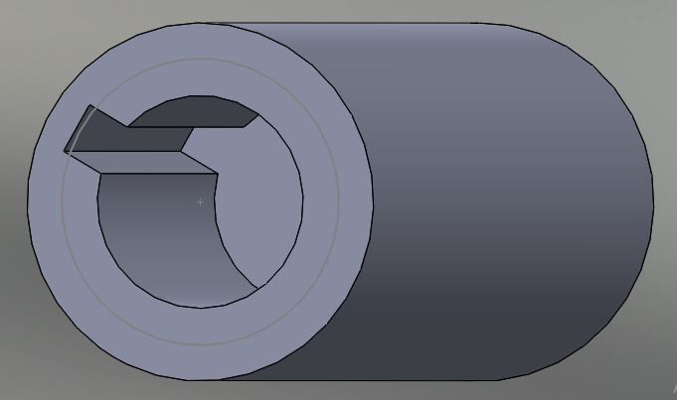
KEYED PART - PUMP COUPLING

Slide 14
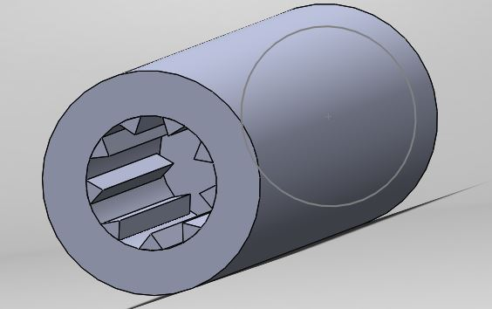
SPLINED PART - PUMP COUPLING

Slide 15
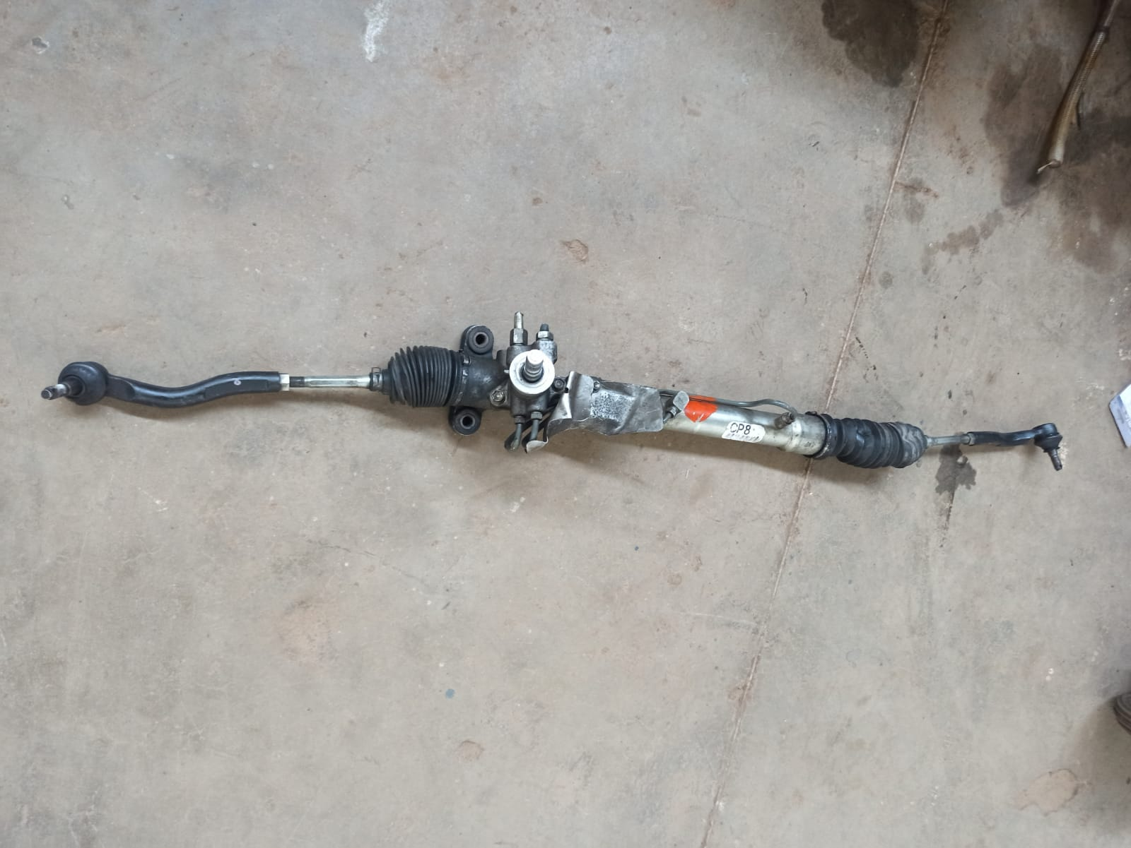
STEERING RACK

Slide 16
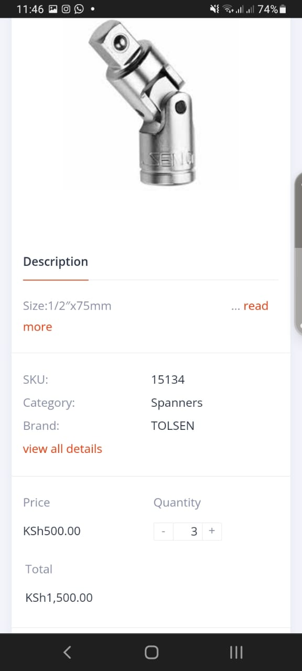
UNIVERSAL JOINT

Slide 17
TO DO
Fabrication of flywheel-motor coupling at the engineering workshops
Acquisition of materials
Fabrication of steering system
Outsourcing hydraulic pump coupling

